Slide 1


Major Project
Title: VOYAGE VISTA– Integrated Travel Booking Platform
Presented by:
Devisha Bhatnagar(500091550)
Mohd Fahad Khan(500091622)
Guided by:
Mr. Keshav Sinha
Assistant Professor (SS)
Systemics Cluster
School of Computer Science

Slide 2
Content
Introduction
Problem Statement
Tech-Stack
Methodology
Objectives
Flowchart
Pert Chart
References

Slide 3
Introduction
This project introduces an advanced travel planner app built with Next.js 14, aimed at transforming the flight and hotel booking experience. By harnessing Puppeteer and Redis for dynamic real-time data scraping and integrating the Bright Data scraping browser for ethical data collection, the app provides users with the most up-to-date and accurate travel options. It features a robust admin dashboard for effective management of user data, bookings, and scraping logs, and incorporates secure payment processing through Stripe to ensure a smooth transaction experience.
The app's intuitive user interface and sophisticated backend functionalities, including job management and API routes, are all seamlessly deployed on App Table. This platform not only addresses the need for an integrated booking solution but also sets a new benchmark in travel technology with its comprehensive, scalable, and user-centric approach.

Slide 4
2. Problem Statement
Today’s travel booking sites and applications face many challenges, including:
Technical issues
Data duplication
Overbooking
Lack of personalization
By leveraging advanced technologies like next.js for scalable deployment, Prisma for efficient data management, and web scraping for real-time data aggregation, this project seeks to create a more seamless and personalized travel planning experience.

Slide 5
3. Tech Stack
PostgreSQL
Prisma
Database
Front-end & Back-end
Next.js 14
Aptible
Docker
Deployment
Tailwind CSS
TypeScript
Designing Interface
Stripe
Redis
Payment Gateway
Puppeteer
Bright Data
Web Scrapping

Slide 6
4. Objectives
Unified Travel Booking Experience:
Develop a single platform that seamlessly integrates the booking of flights, accommodations, and potentially other travel components like tour guides and activities.
Eliminate the need for users to navigate multiple platforms, providing a more convenient and streamlined booking process.
Real-Time Data Aggregation and Presentation:
Utilize web scraping techniques to gather and present the latest travel information, including prices, availability, and deals.
Ensure users have access to the most up-to-date and competitive options when planning their trips.

Slide 7
5. Methodology
1. Setting Up the Development Environment : Ensure the latest stable versions of Node.js and npm are installed in a well suited IDE.
2. Front-End Development : Design and implement reusable React components for the user interface.
3. Web Scraping : Design the PostgreSQL database schema with appropriate tables and relationships.
4. Back-End Development : Define API endpoints using Next.js API routes and gather real-time travel data using web scraping techniques with Puppeteer.
5. Database Management : Design the PostgreSQL database schema with appropriate tables and relationships.
6. Integration & Testing : Ensure seamless communication between front-end and back-end using API calls

Slide 8
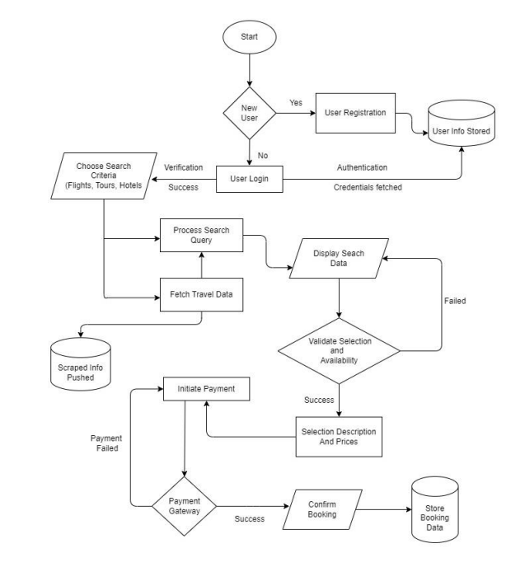
6. Flowchart

Slide 9
7. Pert Chart
STUDY PERIOD
001 | 7 DAYS
5 AUG 2024 | 12 AUG 2024
REQUIREMENT GATHERING
002 | 4 DAYS
13 AUG 2024 | 17 AUG 2024
DOCUMENTAION
003 | 3 DAYS
18 AUG 2024 | 21 AUG 2024
DESIGN
004 | 16 DAYS
23 AUG 2024 | Est. 9 SEP 2024
CODING and IMPLEMENTATION
005 | 30 DAYS
10 SEP 2024 | Est. 10 OCT 2024
TESTING
006 | 17 DAYS
11 OCT 2024 | Est. 28 OCT 2024
DEBUGGING
007 | 9 DAYS
28 OCT 2024 | Est. 06 NOV 2024
REPORT PUBLISH
008 | 15 DAYS
07 NOV 2024 | Est. 22 NOV 2024

Slide 10
8. References
Chen, L., Wang, S., & Liu, J. (2018). A framework for an integrated travel planning and booking system based on big data analytics. Tourism Management, 69, 456-470.
Expedia Group. (2023). Annual Report.
Booking Holdings. (2023). Annual Report.
Töscher, A., & Jahrer, M. (2009). The Big Five of Tourism Marketing. Journal of Travel Research, 48(1), 14-24.
Zheng, Z., Qin, R., Chen, Q., & Chau, M. (2018). Big data analytics in tourism research: A review. Tourism Management Perspectives, 28, 120-128.
Xiang, Z., Tussyadiah, I., & O'Leary, J. T. (2017). Understanding the role of mobile technology in travel information search. Journal of Travel Research, 56(3), 365-378.
Next.js Documentation. (2023). Retrieved from https://nextjs.org/docs.
Prisma Documentation. (2023). Retrieved from https://www.prisma.io/docs/
PostgreSQL Documentation. (2023). Retrieved from https://www.postgresql.org/docs/
Stripe Documentation. (2023). Retrieved from https://stripe.com/docs
Redis Documentation. (2023). Retrieved from https://redis.io/docs/

Slide 11
Thank You

